Slide 1
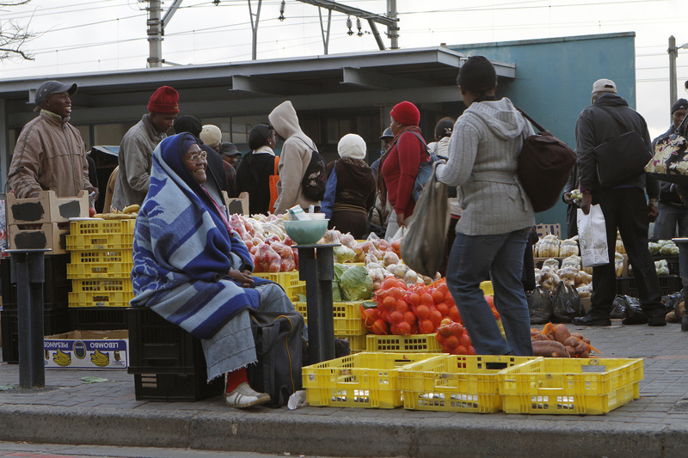
THE SIGNIFICANT CONTRIBUTION OF INFORMAL ECONOMY TO ECONOMIC GROWTH IN South Africa’s and labour market
MATHEMATICAL SCIENCES PROJECT 3 (MSP360S)
Name: Mkhonto Hendry mike
Student no: 221026908
ACADEMIC SUPERVISOR: Dr Buzuzi
COMPANY MENTOR(S):MR Zukile Ncapayi
This Photo by Unknown Author is licensed under CC BY-ND

Slide 2
CONTENTS
Introduction
Methodology
Result and Discussion
Conclusion
References

Slide 3
Introduction
What is informal economy ?
What is the importance of informal economy ?
Problem statement
What are the Informal economy activities ?
Notes:
The informal economy play a crucial role in economic landscape
This presentation explores the impact on economic growth and labour market and explore its opportunities and challenges

Slide 4
Intro:BACKGROUND
“informal sector” Originates from apartheid-era policies by John Keith Hart 1973 while doing his research about Kenya economy.
Current structure, after nearly two decades since the ending of apartheid colonialism, poverty, unemployment, inequality, and environmental degradation remain persistent problems South Africa (Kantor, 1999)
Most South African countries gained political independence in the 1950s and 1970s and South Africa became politically independent in 1994(Ntuli, 2020)

Slide 5
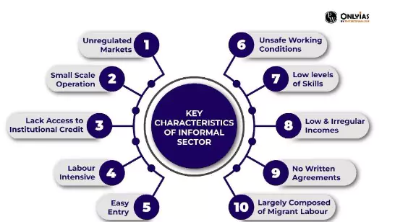
What is INFORMAL ECONOMY
According to Tokman state that it's an economic activities that have market value and that is neither tax or registered by the government, often operate outside the formal labour market (1980).
Activities of informal economy:
.
Home-Based Workers (Domestic Workers)
Street Vendors.
Waste Pickers.
Informal transportation (e.g., unregistered taxis)
Annual Periodic Labour Force Survey Report (PLFS) 2022-23

Slide 6
THE SIZE AND COMPOSITION OF INFORMAL?
2 billion workers (61.2% of global workforce) from the age of 15 and above (ILO,2018).
More than 300 000 people are engaged in community and social services (Simelane,2012)
Trade, social , agriculture and community services contribute to 60% of employment in informal economy
Urban areas have higher informal employment rates than rural.
Past Estimates: 10-12% contribution to economic growth (2010-2015) (Ngcobo,2018).
Importance of informal economy
Provide jobs for those who are unable to find jobs in the formal sector
Encourages entrepreneurship as self-employment
Reduce poverty and raise productivity to economy.
Helps for skills development and gain experience, which can lead to formal job opportunities in the future
Notes:
Impact of COVID-19: Informal sector faced significant challenges
Contribution may rise to 10-15% post-pandemic(hart,2015).
Formal economic activities are mostly found in the Central Business District in Cape
Town, where there are corridors such as CBD, Bellville and Mowbray which account for
34% proximate population

Slide 7
Challenges Faced by the Informal Economy
1
Lack of Access to Financing
Informal businesses often lack the collateral or credit history to secure formal financing, limiting their growth potential for their businesses.
2
Regulatory Barriers
Informal workers and businesses may face challenges, such as difficulties in obtaining licenses and proper infrastructure.
3
Vulnerability to Exploitation
Informal workers are susceptible to exploitation, with limited legal protections and access to social safety nets.

Slide 8
Intro: problem STATEMENT
This research aim to develop strategies to formalize the informal economy in South Africa
Goals: Enhance economic growth, employment, and tax revenue; ensure social security for informal workers
Notes:
According to Rogerson (2016, pp.172-186) point that the more the province has large number of informal sector has a strong foundation to be able to move from informal to formal sector because as the economy grows also the firms grows and become competitive sector.

Slide 9
Intro:Research questions
What is the current state and structure of the informal economy in South Africa?
Which sectors of the informal economy contribute most to economic growth?
What is the role of government policy in regulating or supporting the informal
What demographic factors, most associated with labors in the informal economy?

Slide 10
Intro: RESEARCH OBJECTIVE
Primary objective of this study is to assess the impact and contribution of the informal economy on economic growth within South Africa's labor market
To analyze demographic and geographic factors affecting informal sector participation and to identify the role of the informal economy in job creation for labours and poverty reduction
Notes:
secondary objective to evaluates the potential economic, social, and environmental impacts of formalizing the informal economy on economic growth, employment creation, tax revenue generation, labor rights, and working conditions

Slide 11
LITERATURE REVIEW
Cohen & Simelane(1993):
Tied to apartheid-era racial exclusion
ILO( 1993) :
linkage between formal and informal economy could boost economic growth
Patricia de Lille (2015):
Mayor of Cape Town states that refugee has value in the informal sector to boost economic growth
Heintz & Posel (2008):
Education attainment and income
Saunders ( 2005):
Geographic and Demographic Traits: Disparities based on race and migration
UNDP (2017):
campaign to help informal know as Sustainable livelihood approach (SLA)
Rogan & Skinner (2018):
Current challenges- Inequality, competition labour, High unemployment and limited access to capital

Slide 12
Methodology
Data source
This research will look at secondary real-world dataset of QLFS, dataset was found from StatsSA (Quarterly Labor Force Survey) of Q4:2023. This survey present sample size of approximately 30,000 households.
Research Design:
This study propose to use a quantitative method for statistical analysis. The target population of this research is Western Cape, Gauteng, KwaZulu Natal province of informal businesses.
Notes:
(QLFS) is a sample survey that is conducted by Statistics South Africa (StatsSA). Its use is to collect data on labour market activities of individuals who are working or not working from the age group of 15 years and above

Slide 13
DATA DISTRIBUTIONS
Table 1.1 Display summary of binary logistic regression:
Variable Type | Name | Description | Type | Measurement
Dependent Variable | Y:Employment Status | 0= Employed 1=Unemployed | Coded Binary | Nominal
Independent Variable
 | X1:Informal employment | % percentage of labour force | Continuous | Ordinal
 | X2: Age group | 15-24,25-34,35-44, etc. | Category | Ordinal
 | X3:Education Status | Primary, Secondary, Tertiary, etc. | Category | Ordinal
 | X4:Gender | Male , Female | Category | Nominal
 | X5:Geography | Urban, Rural | Category | Nominal
 | X6:Province | Western Cape | Category | Nominal

Slide 14
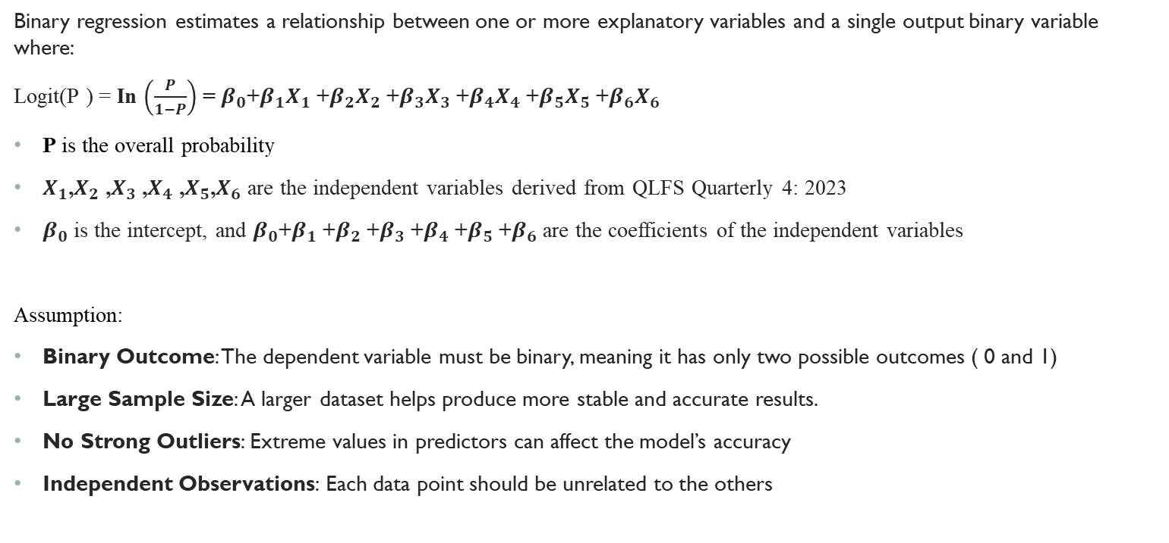
Binary Logistic Regression Model
Binary regression estimates a relationship between one or more explanatory variables and a single output binary variable where:
Logit(P ) = In $\left(\frac{P}{1−P}\right)$ = $β_{0}$+$β_{1}X_{1}$ +$β_{2}X_{2}$ +$β_{3}X_{3}$ +$β_{4}X_{4}$ +$β_{5}X_{5}$ +$β_{6}X_{6}$
P is the overall probability
$X_{1}$,$X_{2}$ ,$X_{3}$ ,$X_{4}$ ,$X_{5}$,$X_{6}$ are the independent variables derived from QLFS Quarterly 4: 2023
$β_{0}$ is the intercept, and $β_{0}$+$β_{1}$ +$β_{2}$ +$β_{3}$ +$β_{4}$ +$β_{5}$ +$β_{6}$ are the coefficients of the independent variables
Assumption:
Binary Outcome: The dependent variable must be binary, meaning it has only two possible outcomes ( 0 and 1)
Large Sample Size: A larger dataset helps produce more stable and accurate results.
No Strong Outliers: Extreme values in predictors can affect the model’s accuracy
Independent Observations: Each data point should be unrelated to the others

Slide 15
Data analysis
This research will use Statistical Software R for regression analysis
We used duplicated() function remove duplicates, ggplot to plot the graphs, is.na(), na.omit() to handle missing values
Data Limitations: Although the QLFS provides an entire dataset, it might not fully capture every detail of the informal economic activities in rural areas or countryside areas.
Descriptive statistics will be used to summarize the key findings and use the Confidence Interval for intern reliability of the data
The P-value at 5% significant level, odds ratio of values to determine the significant of the informal sector
Regression analysis will evaluate the relationship between formal regulation and economic outcomes in the informal economy.

Slide 16
Results & Discussion
Table 1.2 Display summary of binary logistic regression:
Notes:
The standard error for each variable measures the level of variability
A larger standard error suggests more uncertainty, while a smaller standard error indicates that the estimate is more precise.
In summary, while the standard errors indicate some uncertainty in the precise impact of each variable, the very low residual deviance suggests that the model does a good job explaining the variation in economic outcomes.
"Informal_employment," the standard error is approximately 6.33. This value indicates a moderate level of uncertainty around the coefficient estimate (-2.781e-07) for informal employment.
"GENDER" with 5.561, "Geography type" with 5.014) suggest that these estimates may vary widely, meaning that their influence on economic growth is less precisely measured.
Residual deviance measures how well the model fits the data
The residual deviance of 9.6591e-08 on 16,642 degrees of freedom indicates that, after accounting for the variables included in the model, there is still some variability left unexplained.
However the very low residual deviance suggests that the model captures most of the variation in the data

Slide 17
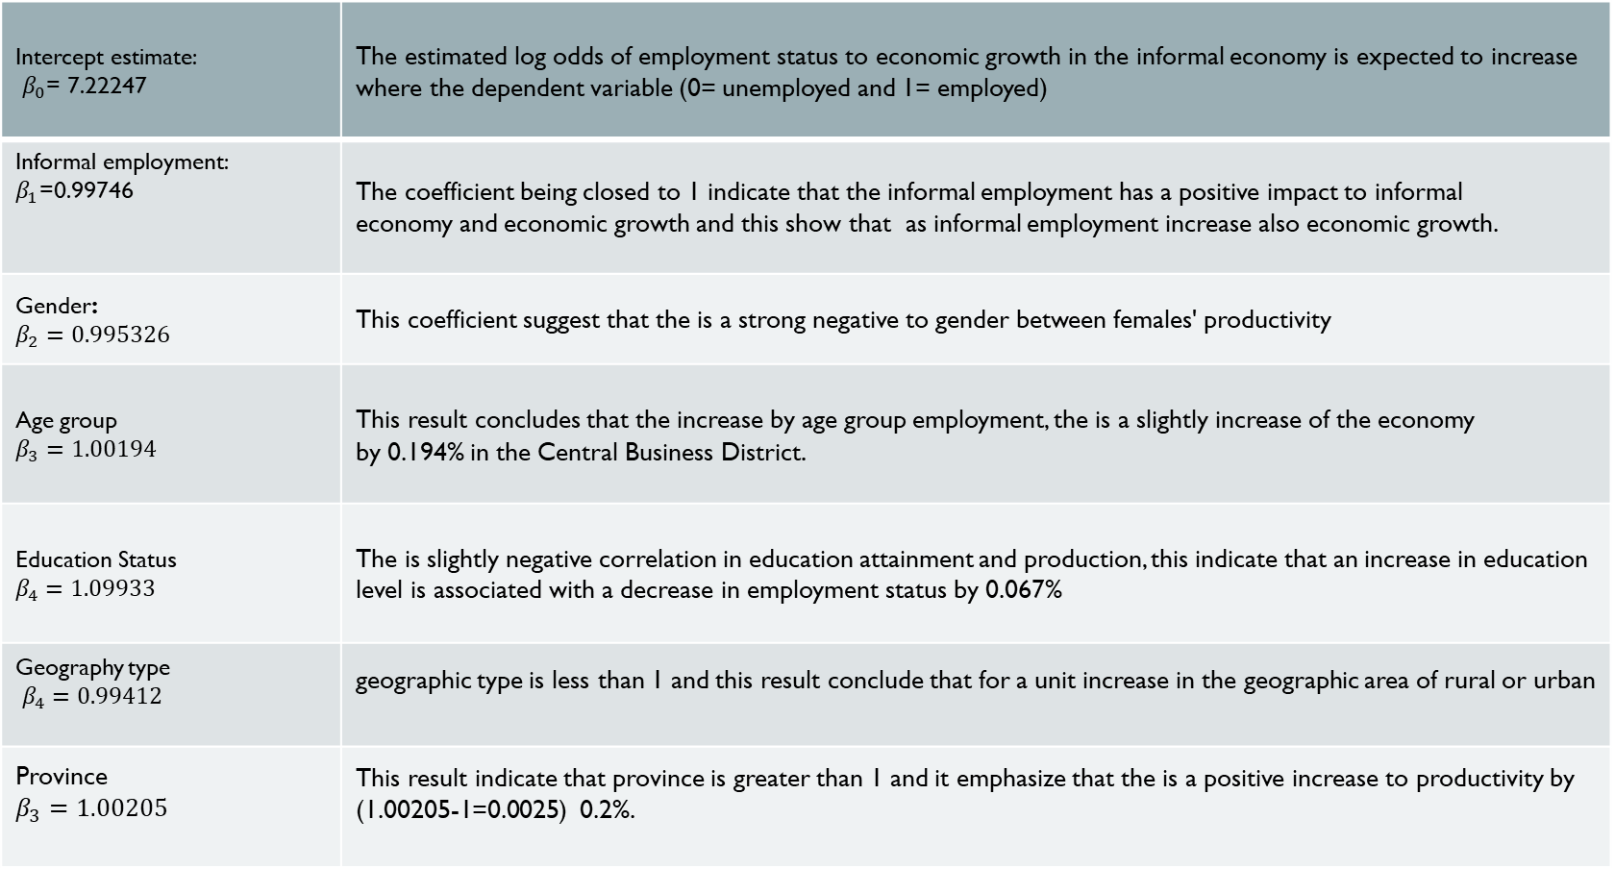
Intercept estimate: $β_{0}$= 7.22247 | The estimated log odds of employment status to economic growth in the informal economy is expected to increase where the dependent variable (0= unemployed and 1= employed)
Informal employment: $β_{1}$=0.99746 | The coefficient being closed to 1 indicate that the informal employment has a positive impact to informal economy and economic growth and this show that as informal employment increase also economic growth.
Gender: $β_{2}=$ $0.995326$ | This coefficient suggest that the is a strong negative to gender between females' productivity
Age group $β_{3}=1.00194$ | This result concludes that the increase by age group employment, the is a slightly increase of the economy by 0.194% in the Central Business District.
Education Status $$β_{4}=1.09933$$ | The is slightly negative correlation in education attainment and production, this indicate that an increase in education level is associated with a decrease in employment status by 0.067%
Geography type $β_{4}=0.99412$ | geographic type is less than 1 and this result conclude that for a unit increase in the geographic area of rural or urban
Province $$β_{3}=1.00205$$ | This result indicate that province is greater than 1 and it emphasize that the is a positive increase to productivity by (1.00205-1=0.0025) 0.2%.

Slide 18
Table 1.3 Display of Odd Ratio from logistic coefficient
Coefficient: Odds Ratio 95% CL
Intercept | 3.447452e+11 | -
Informal Employment | 0.99746 | ( 0.345, 0.61 )
Gender | 0.995377 | ( 1.05, 1.40 )
Age group | 1.0019435 | (0.62, 2.60 )
Education_Status | 1.093383 | ( 1.90, 3.15 )
Geography type | 0.9941277 | ( 0.97, 2.23 )
Province | 1.202056 | (1.22, 5.36 )
Notes:
The odds ratio >1 indicates a positive association between informal employment. The CI is between 0.345-0.61 indicate that even if its contribute to employment suggest statistical significant.
CI have a significant value of more than 1, indicate that the is a slight positive contribution to economic growth
Wide confidence interval (0.62 to 2.60) suggests high variability in how different age groups may influence economic outcomes
Education has a strong positive significant with a CI of 0.32% contribution to economic growth.
The CI increase by 1.26% in geography indicate that urban areas is a place where informal sector are find and its contribution
This suggests that the region where a school or community is located might significantly influence economic growth, potentially reflecting regional disparities.

Slide 19
Table 1.4 Informal employment descriptive statistics
Value | Label | n | Percentage %
0 | Informal employment | 5181 | 31,12
1 | Formal employment | 11468 | 68,88
Total | Employed | 16649 | 100

Slide 20
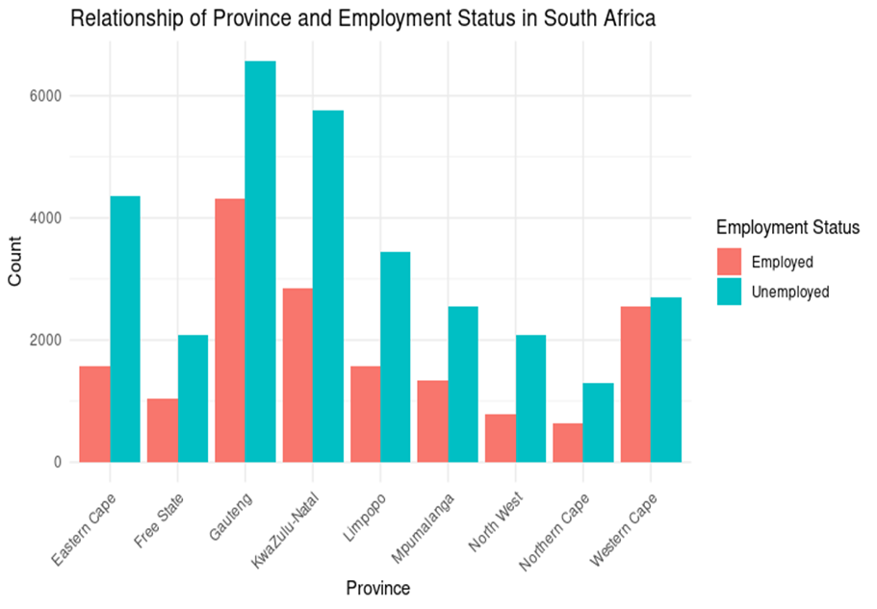
Bar graph of the relationship of employment status by provinces in South Africa
Figure 1.1 Relationship of Province and employment status in South Africa
Notes:
Gauteng , Kwazulu Natal and Western Cape shows that they have the highest count >2000 to 8000 unemployed
Mpumalanga and Limpopo have significant unemployment population because this region are more rural and don’t have much industrial.
Most cities where informal economy strive is Johannesburg and Cape Town such as domestic worker, transport and street vendor

Slide 21
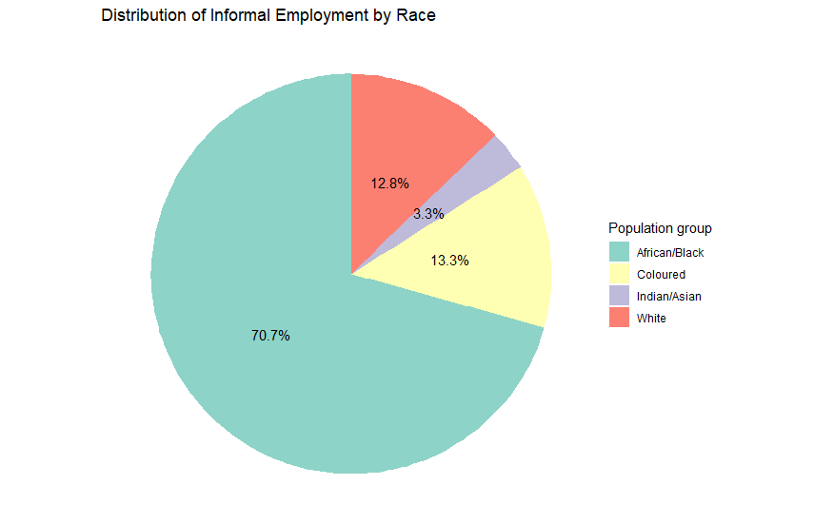
Pie chart graph of distribution of population group by employment status
Figure 1.2 Distribution of informal employment by population group
Notes:
High rate of Unemployment led people starting their own business in order to make a living.
White and Indian population indicate that most have better access to formal employment
Figure 1.1. This study has view that in the population group, most African are dominant in the informal employment by 70.7.
This result indicates that most people who will be found in the informal sector are African and colored due to their population size.
South African informal economy plays a significant role to the economic growth, because it helps to reduce poverty.
This analysis indicates that the government should suggest policy measure in improving the condition of the informal sector but most likely on the African population

Slide 22
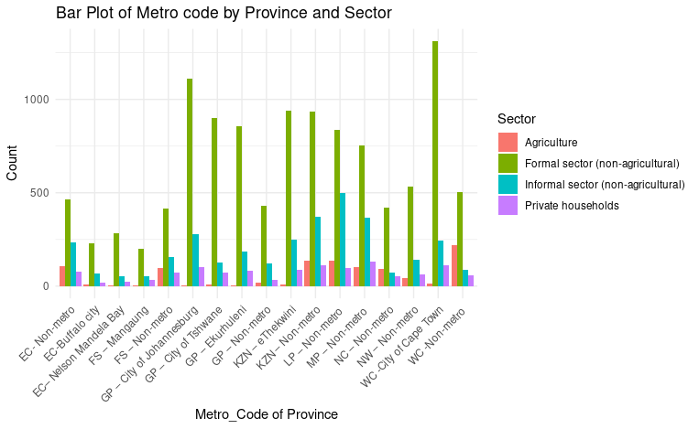
The metro code contribution to each sector in the informal economy
Figure 1.3 Metro code by province in each sector
Notes:
The city of Johannesburg and city of Cape town have a significant proportion in the formal sector(non-agricultural) which contribute account of more than 1000.
In the informal sector, the agricultural play a significant role to labours in some region, such as non-metro code areas in the province
The private household conclude that the is less labour who are doing domestic workers, the informal sector provides job opportunities in region where the is high unemployment rate

Slide 23
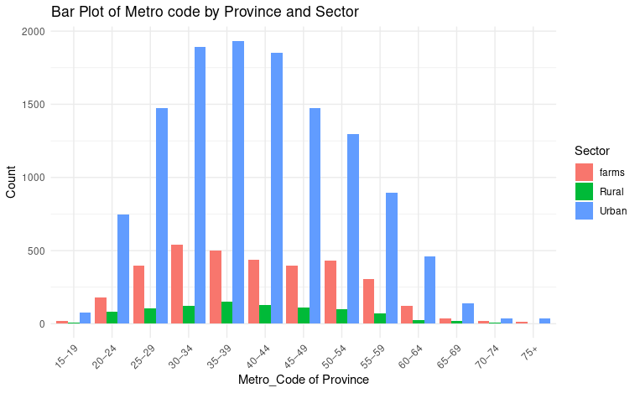
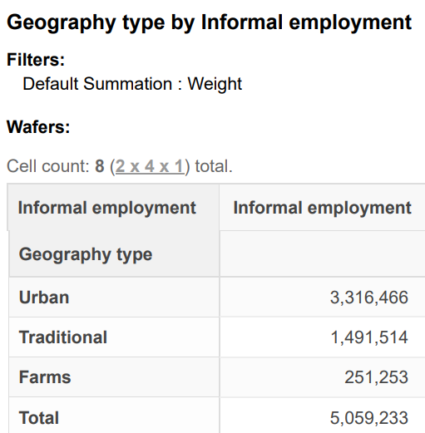

The relationship of age group in the informal economy
Rural
Farms
Figure 1.4 Age group of employment by sector
Notes:
This graph supports our objective because it indicates that most people are employed in the CBD (Central Business District) in the urban area
From age group of 15 to 35, this graph indicates that most people start working and this state that the more the age group grow people move in the urban area to seek for employment
The dominance of the urban sector indicates that the area is contributing to economic growth, for example city of Cape Town

Slide 24
Conclusion
This research conclude that the informal economy does contribute to economic growth of Western Cape. To achieve our objective, we have
Conclude that informal employment contribute 31,12% in year 2023
Province , Age group, education status contribute more to informal economy
On our findings we conclude that gender does not significant to economic growth due to inequalities or limitations.
Population group does not have a significant influence in economy because the is a lot discrimination
An increase in age group, the more people move to informal, and it has a positive contribution.
Education level contribute to economy because some can be able to move from informal to formal sector.
Informal employment has a positive impact because it create job opportunities, reduce poverty.
The higher the industrial increase the probability of economic growth of a country by province
Notes:
GDP contribute approximately 30% and 2.5 Million employment (Ntuli S, 2022)

Slide 25




Policy Recommendations and Strategies
Regulatory Reform LRA
Skills Development Act
Streamlining administrative processes and reducing barriers to formalization can help informal businesses and workers integrate into the formal economy.
Providing training, mentorship, and access to resources can enhance the capabilities of informal entrepreneurs and workers.
Access to Financing SAA
Social Protection CPA
Extending social safety nets and labour protections to informal workers can improve their working conditions and overall well-being.
Developing tailored financial products and services can help informal businesses access the capital they need to grow and thrive.
Notes:
Strategy for informal economy:
NIBUS (National Informal Business Upliftment Strategy – used to support informal businesses , address their challenges
SETA Training Programs- provide training and skills to informal workers to improve productivity
Future Strategy technology transformation:
Mobile banking introduce to make it simple to trade and manage their finance
Case study of successful enterprise:
Real life scenario like brazil and India
India- used of technology for formalization to informal worker
- mobile application provide training and support
- access to financial services through digital
Brazil –focus on reducing barrier for informal businesses
- Government provide training and resources for informal workers

Slide 26
References
Hart, K., 1973. Informal income opportunities and urban employment in Ghana. The journal of modern African studies, 11(1), pp.61-89.
Ntuli, I.S., 2020. Informal trading in post-apartheid South Africa: an examination of the experiences of black African women street traders in Durban (Doctoral dissertation).
Tawodzera, G. and Chikanda, A., 2016. International Migrants and Refugees in Cape Towns Informal Economy. OSSREA.
Rodríguez-Pose, A., 2002. The role of the ILO in implementing local economic development strategies in a globalized world.
Rogan, M. and Skinner, C., 2017. The nature of the South African informal sector as reflected in the quarterly labour-force survey, 2008-2014. Cape town: University of Capetown.
StatsS.A., 2011. Statistics south africa. Formal census, 1, pp.79-106.
Valodia, I., 2013. Bringing the informal economy into the National Development Plan. Social dynamics, 39(1), pp.115-118.
Skinner, C., 2002. Understanding formal and informal economy labour market dynamics: A conceptual and statistical review concerning South Africa (p. 25). Durban: School of Development Studies, University of Natal.
Brown, M., 2010. Review on the environment of women workers in the informal economy in South Africa.
Margolis, D., Rosas, N., Turay, A. and Turay, S., 2016. Findings from the 2014 Labor force survey in Sierra Leone. World Bank Publications.
Kabeer, N., 2008. Mainstreaming gender in social protection for the informal economy. Commonwealth Secretariat.

Slide 27


